Slide 1


Tabular Machine Learning
Nicholas Papano

Slide 2
First off: questions from last time?

Slide 3

Data Exploration

Slide 4
Data Exploration
Done when looking through datasets
Figuring out if the data is cleaned or needs cleaning
Looking for interesting trends
Usually specific per dataset

Slide 5

Data Cleaning

Slide 6
The Importance
Remember: “garbage in, garbage out”
Best to think about like a person’s diet
Some algorithms require basic assertions about the data to even run

Slide 7
Some examples - NLP
def remove_non_alphanumeric(text): return re.sub("[^a-zA-Z]", " ", text)
def convert_to_lowercase(text): return str(text).lower()
def remove_stopwords(text): return [item for item in text if item not in set(stopwords.words("english"))]\
def tokenize(text): return word_tokenize(text)

Slide 8
Other Cleaning
Handling missing values
Handling outliers
Type conversions
Aggregating data from multiple sources
Normalizing/Scaling

Slide 9
Feature Engineering

Slide 10
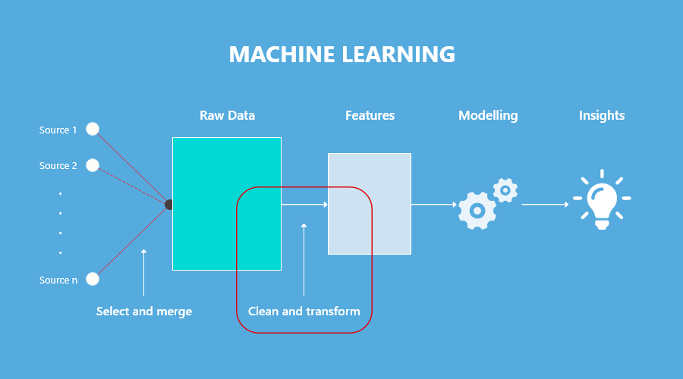
Feature Engineering
Setting up the feature vector
Encoding data
Binning data
Generating new features to use
Sometimes cleaning is grouped in here

Slide 11
Feature Engineering Examples
Have a day of the week column: [“Sunday”, “Monday”, … “Saturday”]
Create new boolean feature: Weekend
1 if weekend, 0 otherwise
Machine learning likes lots of examples, but if the data itself is too complicated, it may struggle to learn

Slide 12
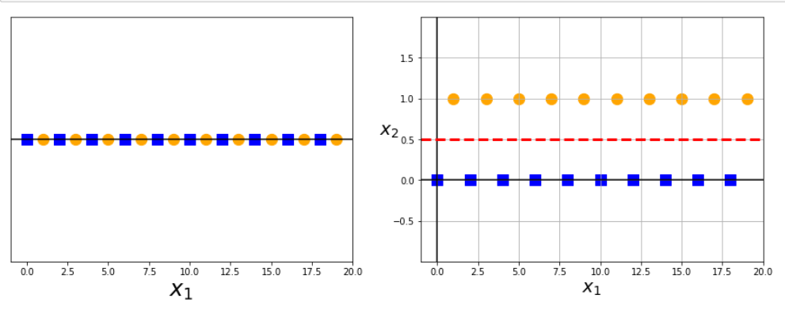
Feature Engineering Examples (cont’d)
Data looks all tangled up
Adding a new feature: the remainder when dividing by two (if it’s even or odd)
Now data is linearly separable

Slide 13
Feature Selection

Slide 14
Feature Selection
Golden question when data is abundant
Sometimes intuition helps
Other times need analysis tools
Commonly used algorithm: Principal Component Analysis

Slide 15
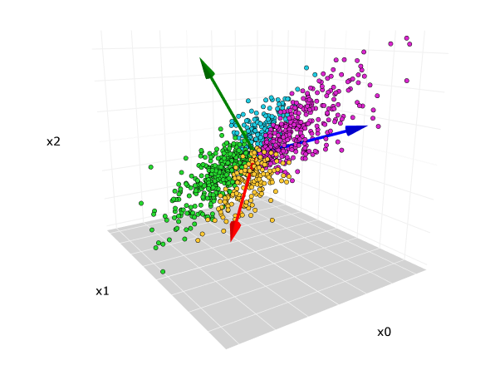

Principal Component Analysis
Comes from mechanics (structural analysis)
Analyzes features and tells you which ones describe the most variance in the dataset
Eigendecomposition of the covariance matrix of the features
A lot of linear algebra that we won’t go into

Slide 16
Data Encoding

Slide 17
Data Encoding
Machine learning algorithms (usually) can’t use non-numerical data
Data must be encoded in numerical form
Categorical data gets mapped to numbers
[“RedCone”, “BlueCone”, “Ball”] => [1, 2, 3]

Slide 18
Data Encoding Examples
The most “universal” form of conversion is to encode data into an image, then the image is used in its numerical form
In natural language processing, words get mapped to feature vectors in many ways
Bag of Words
TF-IDF
BERT + Word2Vector (Really complicated)

Slide 19
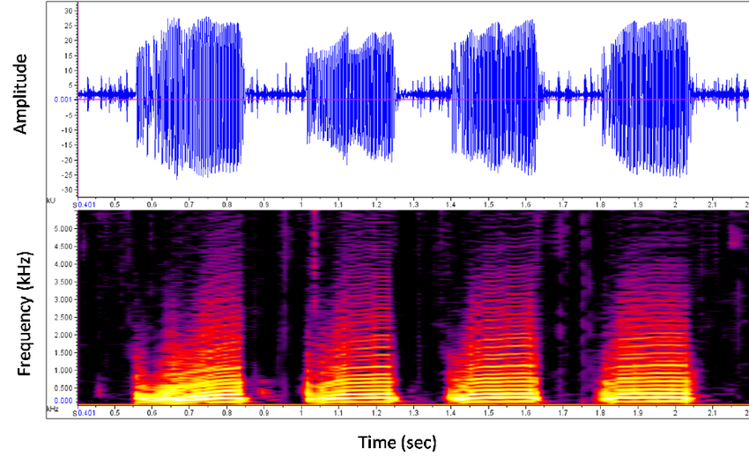
Data Encoding Examples (cont’d)
Convert audio to spectrogram
Colors are generally encoded as RGB (or BGR, it depends ☺)
Black: (255, 255, 255)

Slide 20
Pre-ML Information

Slide 21
Testing and Training Data
In machine learning data is split into validation data and training data
Training data is used to tune the algorithm
The model can see the answers and adjust its knowledge accordingly
Validation data is used to evaluate the model’s performance
Like a quiz on the course content

Slide 22
Golden function: train_test_split
Does input validation
Shuffles up your data
Splits your data into test (validation) and training data

Slide 23
Time to Code!

Slide 24
The Notebook!
Working on the titanic dataset
Covering:
Data Exploration
Data Cleaning
Feature Engineering
Feature Selection
Trying out the various machine learning algorithms

